Slide 1
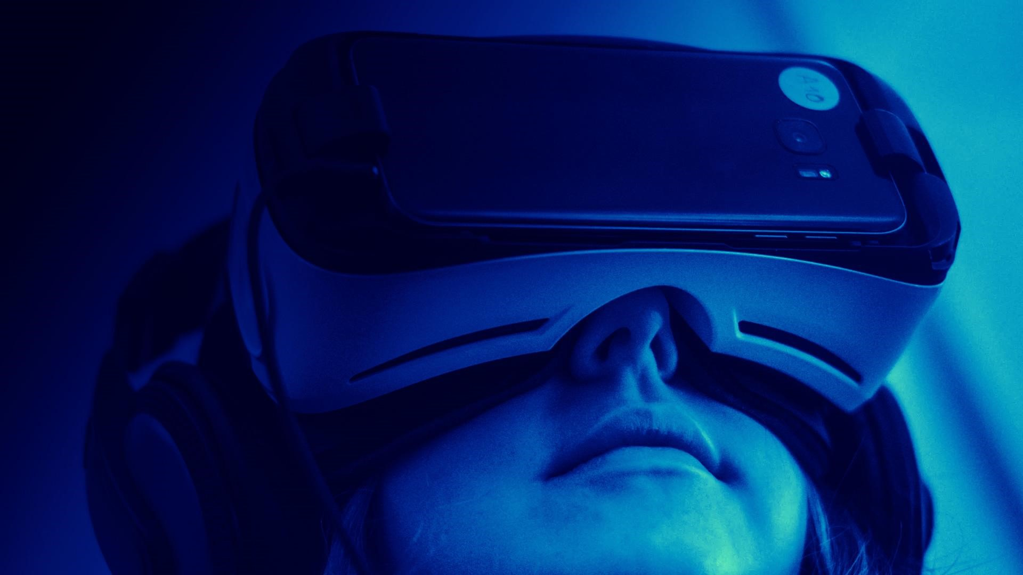
IMMERSIVE TECHNOLOGY
By
S. Nubaish Ahamed

Slide 2
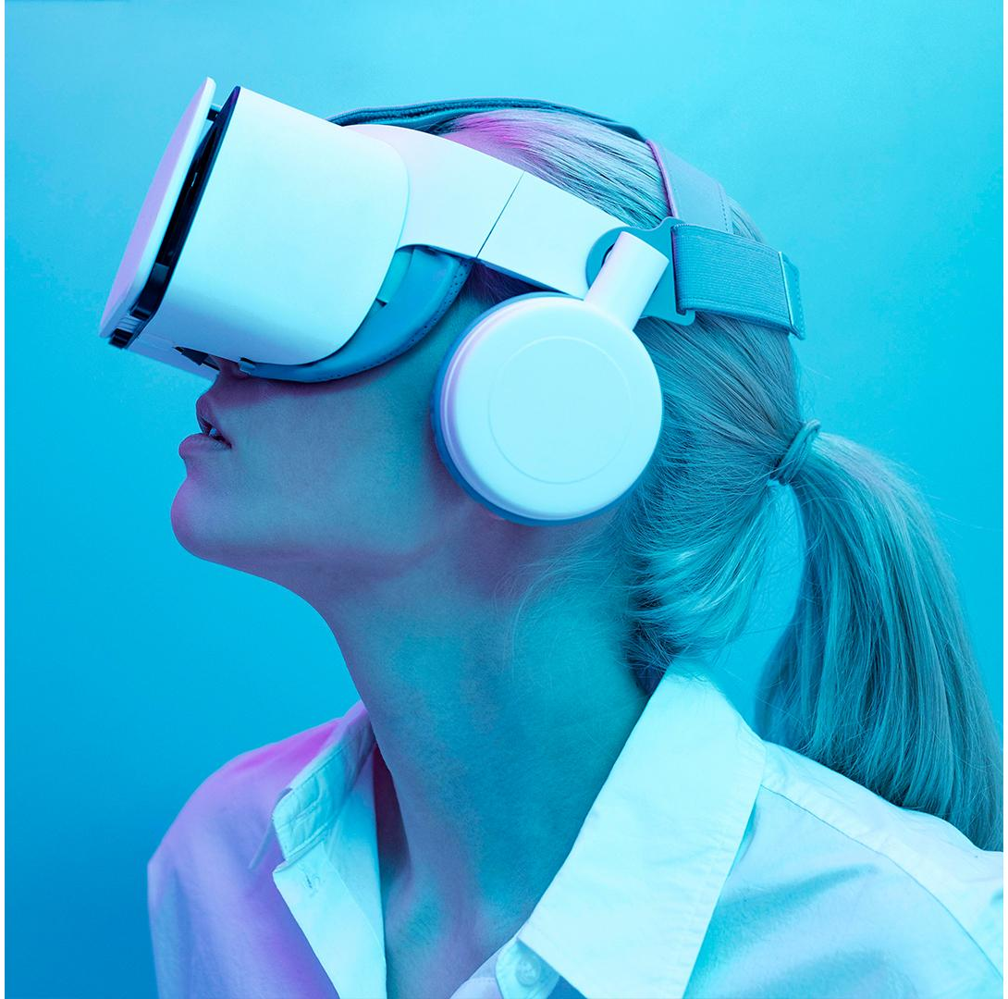






Overview
What is Immersive Technology ?
Extended Reality
Virtual Reality
Future GOALS
Augmented Reality
Mixed Reality
Applications

Slide 3
What is Immersive Technology ?
Immersive technology is an integration of virtual content with the physical environment in a way that allows the user to engage naturally with the blended reality
Immersive technology includes : Virtual Reality (VR), Augmented Reality (AR), Mixed Reality (MR), Holography, Telepresence, Digital Twin, FPV ( First person view ) Drone Flight.

Slide 4
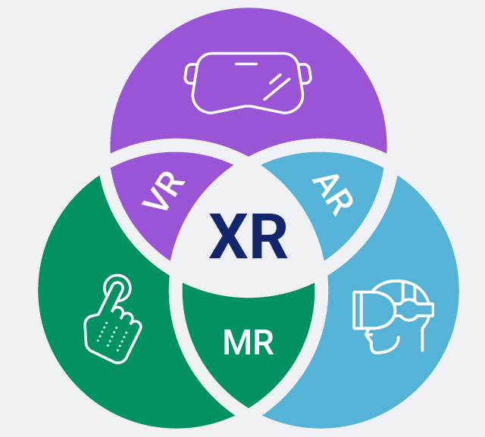
Extended Reality ( XR )
XR stands for “extended reality,” an umbrella term that covers VR, AR, and MR.
All XR tech takes the human-to-PC screen interface and modifies it, either by 1) immersing you in the virtual environment (VR), 2) adds to, or augments, the user’s surroundings (AR), or 3) both of those (MR).

Slide 5
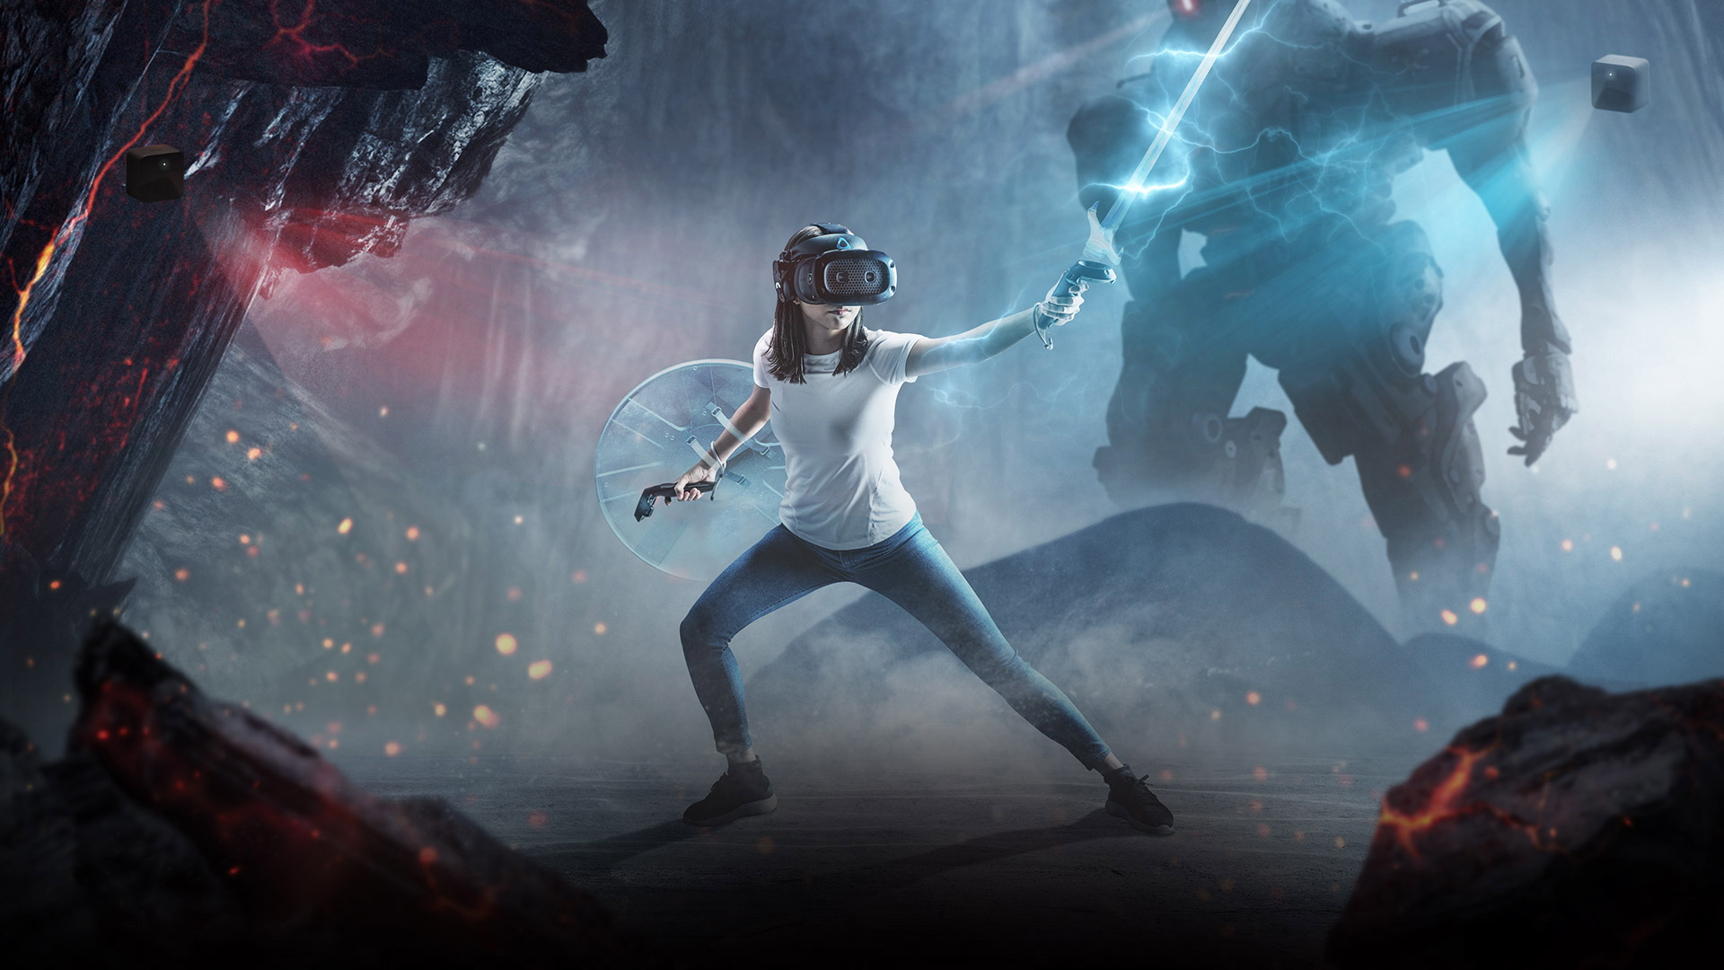
Virtual Reality (VR)
Virtual Reality (VR) is a computer-generated environment which appears to be real, making the user feel they are immersed in their surroundings.
People interact in those environments using, VR goggles or other mobile devices.

Slide 6
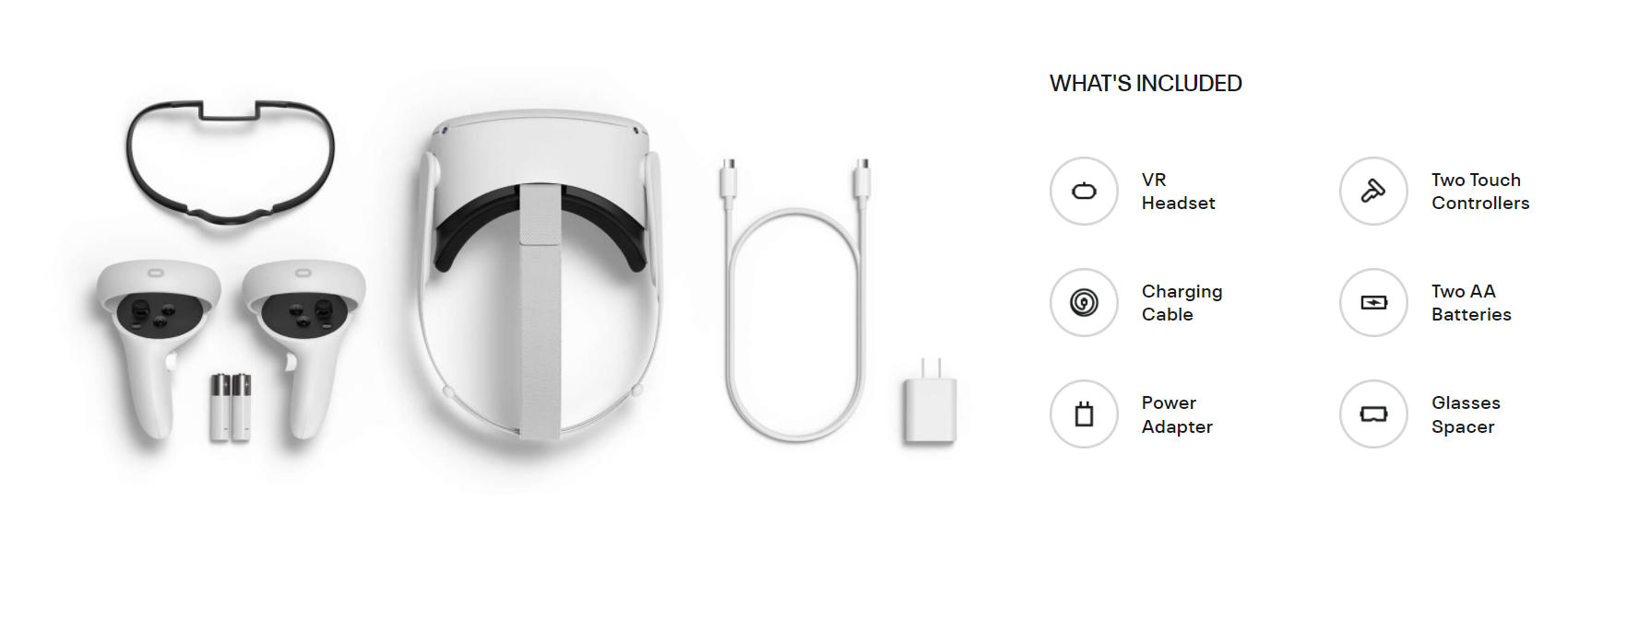
It covers over 114-degree 3D space around.
It uses spatial audio technology to create a simulated audio landscape that matches the visuals created by VR.
Head and position tracking is done (3DoF and 6DoF).

Slide 7
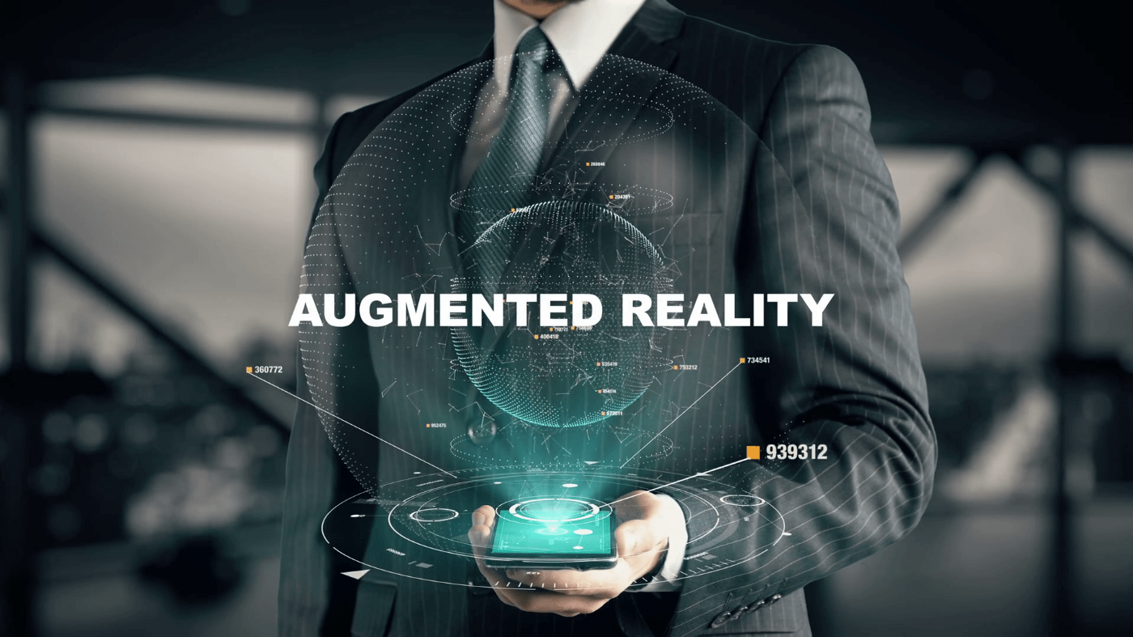
Augmented reality (AR) is a technology that let people super impose or add digital content (images, sounds, text) over a real-world environment.

Slide 8
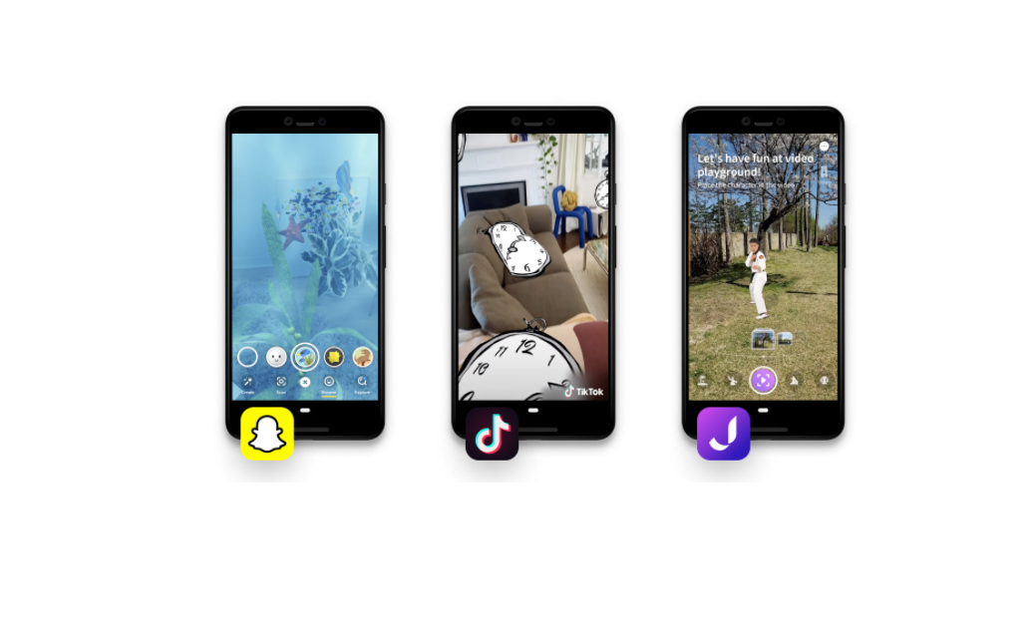
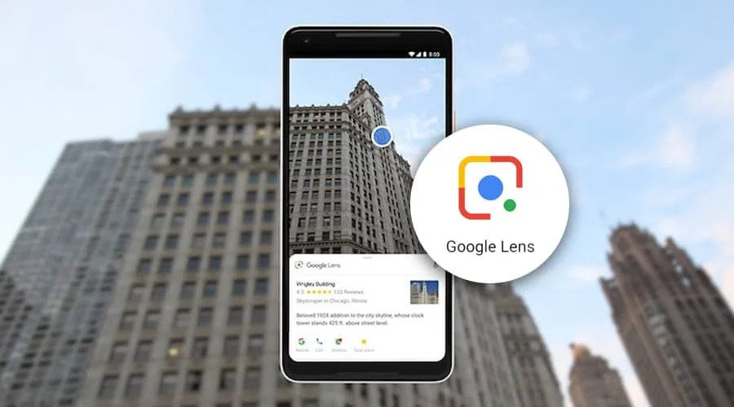
Digital cameras, accelerometers, GPS, gyroscopes, radio-frequency identification (RFID).
These technologies offer varying levels of accuracy and precision.

Slide 9
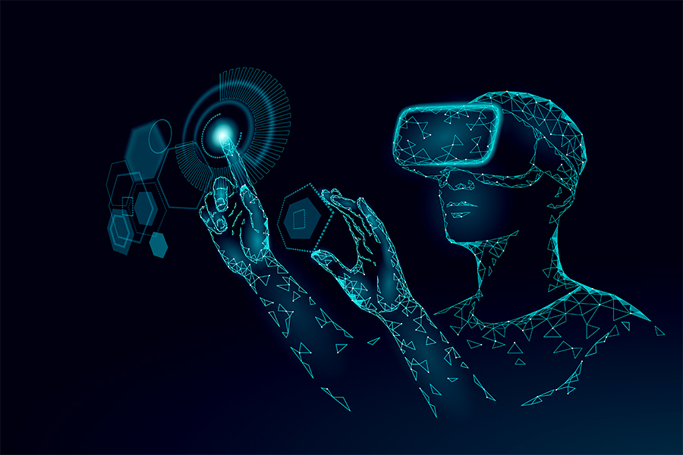
Mixed Reality
Mixed reality is the combination of virtual reality and augmented reality, where physical and digital objects co-exist and interact in real time.

Slide 10
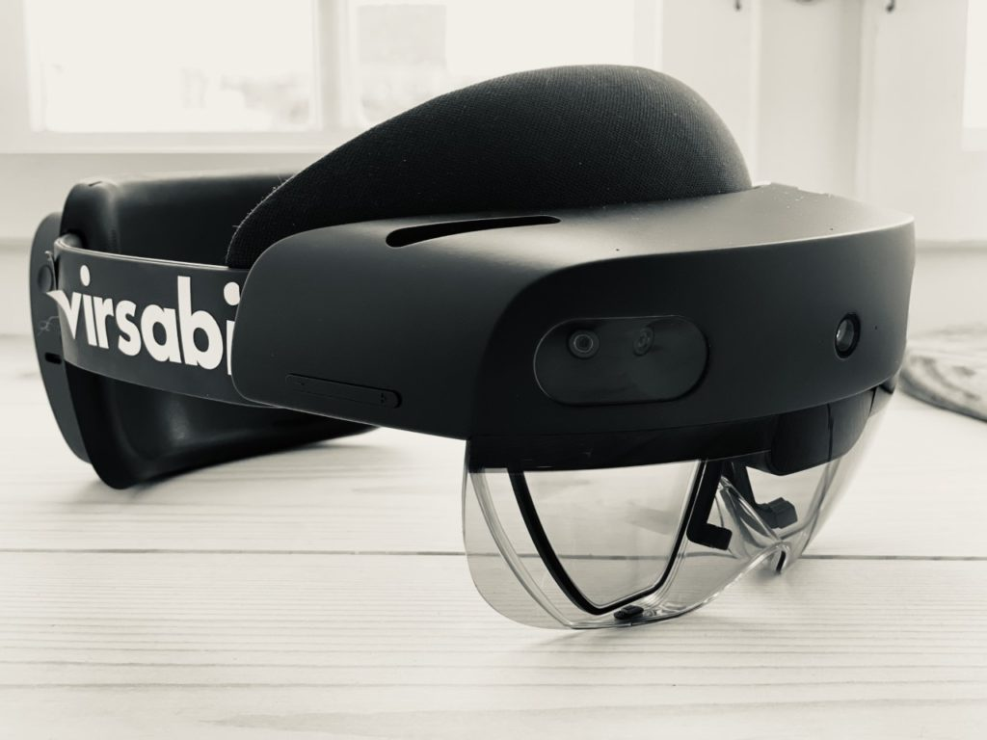
This new reality is based on advancements in computer vision, graphical processing, display technologies, input systems, and cloud computing.
Allows the user to see the physical environment while wearing the headset.
Fully articulated hand tracking, touch, grasp, and move holograms in ways that feel natural.
.
Key features are used in HoloLens are Hand Tracking, Voice Enabled, Eye Tracking, Spatial Mapping .

Slide 11

Applications
Automotive :
Aside from perhaps military and defence, this is the industry most fluent in immersive technology, using it to design, prototype, build, maintain and sell vehicles of all kinds.
Defence :
Simulation has been at the heart of military and defence since the beginning, and the industry was an early adopter. Today, battlefields are immersive, virtual reality training is gamified and portable, and weapons are tested in the irreal before they ever go into production.
Education :
Schools and higher education institutions are on the lookout for immersive technology solutions for online learning, so that they can ensure their students’ safety and deliver their education.
Entertainment :
Immersive movies, games and experiences are becoming big business, online and in the real world. They can be found in homes as headsets become cheaper for consumers, in museums as guests demand more immersion, and at venues as operators seek new ways of attracting customers.

Slide 12
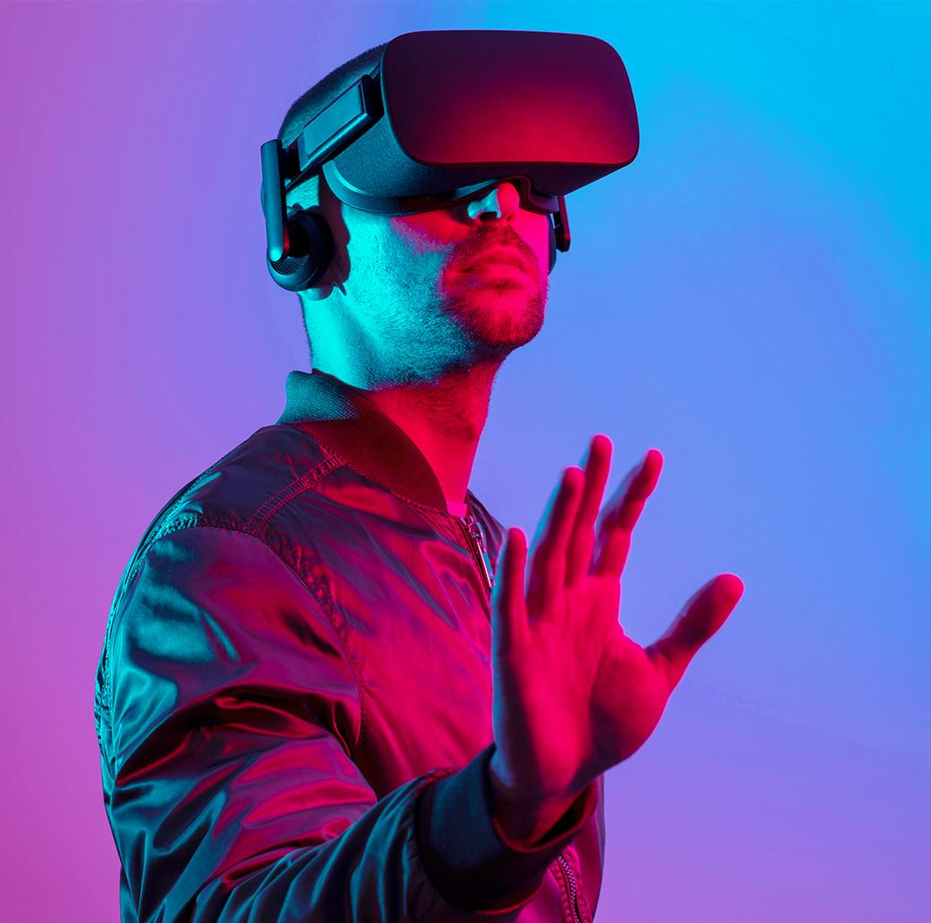
WHERE WE ARE
WHERE WE WANT TO BE
FUTURE GOALS
AR, MR and VR headsets, 3D displays, 3D audio, gesture recognition, spatial sensing, speech recognition.
Immersive technology is aimed at creating a “Mirror World” – a digital layer map, created by fusion of satellite imagery, cameras and other modeling techniques.
“The best way to predict the future is to create it”

Slide 13
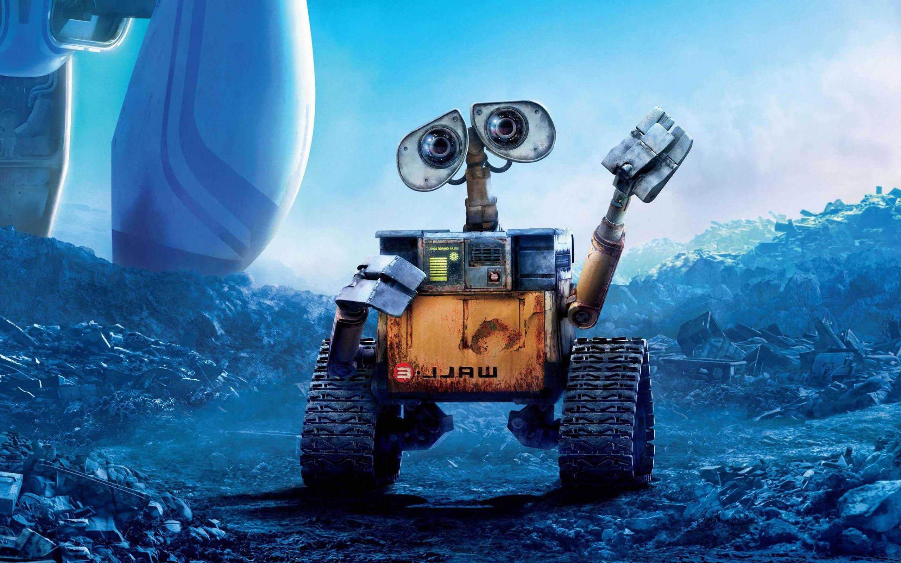
THANK YOU EVERYONE
BYE!!!

